Slide 1


Automated Forensic Solution for AWS EC2 Instances
CS-GY 9223: Cloud Security Prof. Catherine Dodge, Prof. Rima Tanash
Vishnu Vardhan Ciripuram vc2499@nyu.edu

Slide 2
Problem Statement
Traditional memory acquisition is manual and time-consuming, leading to delays in response during security incidents.
Manual processes are error-prone and can lead to inconsistent forensic data collection.
As the number of instances grows, it becomes impractical to manually perform memory acquisition on each one.

Slide 3
Design
Goal: To implement an efficient and reliable automated process for memory acquisition on AWS EC2 instances upon detection of a security incident.
Components: CloudWatch will monitor EC2 for specific triggers like high CPU utilisation.
SNS will notify and trigger a response to incidents.
Lambda function to execute the memory acquisition script.
SSM Document to remotely capture memory on EC2 instances.
S3 bucket for storing memory dumps for analysis.
Flow:
An incident triggers a CloudWatch alarm.
Alarm sends a notification to an SNS topic.
SNS topic triggers a Lambda function.
The lambda function invokes an SSM document to capture the memory.
Memory dump is uploaded to an S3 bucket.

Slide 4
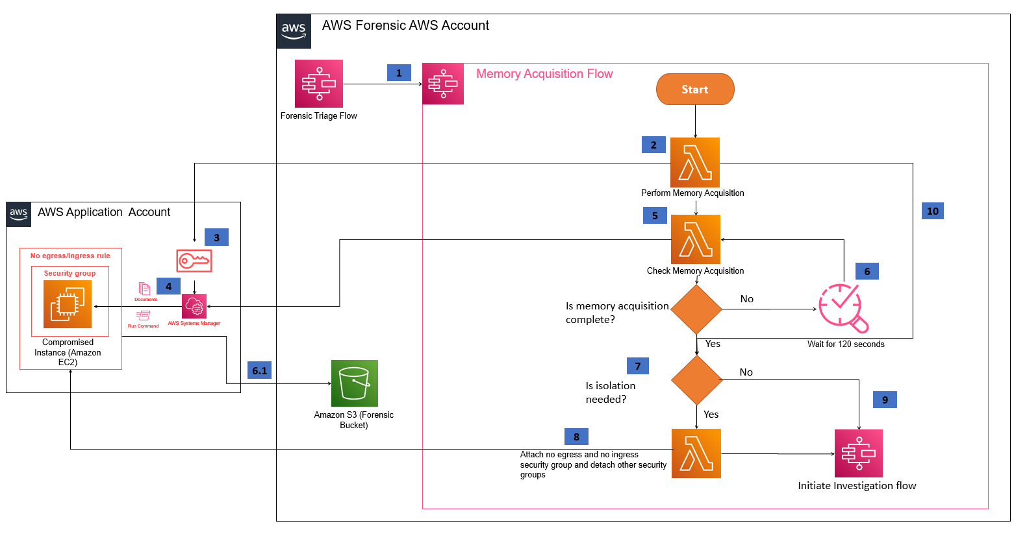
Architecture

Slide 5
Demo
Forensic memory acquisition service

Slide 6
Problems Encountered
Permission Issues: Initial IAM roles and policies needed to be correctly scoped, resulting in permission denials.
Data Volume: Large memory dumps posed challenges with transfer times and storage costs.
Tooling: Dependencies on third-party tools like LiME introduced complexity in automating the acquisition process.

Slide 7
How We Handled Them
Refined IAM Roles: Fine-tuned IAM roles and policies to grant precise access needed for each AWS service.
Optimized Data Handling: Our implementation of data compression and multipart upload to S3 has significantly improved efficiency.
Streamlined Tooling: Dependencies were packaged within the Lambda function where possible, and Amazon Linux 2 AMI provided out-of-the-box support for needed tools.

Slide 8
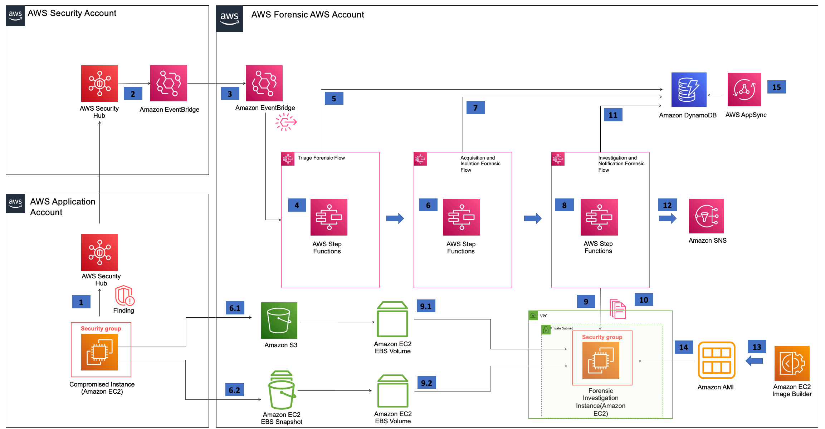
Future Plan
Notes:
Disk Acquisition

Slide 9
References
Forensic memory and disk acquisition service: https://docs.aws.amazon.com/solutions/latest/automated-forensics-orchestrator-for-amazon-ec2/forensic-memory-and-disk-acquisition-service.html
Forensic disk collection automation in AWS: https://aws.amazon.com/blogs/security/how-to-automate-forensic-disk-collection-in-aws/
AWS Orchestrator git:
https://github.com/aws-solutions/automated-forensic-orchestrator-for-amazon-ec2
AWS Solutions Library Page:
https://aws.amazon.com/solutions/implementations/automated-forensics-orchestrator-for-amazon-ec2/

Slide 10


Thank You!

Slide 11
Lessons Learned
Complexity: Learnt the sophisticated aspects of cloud-based digital forensics.
Version Precision: Gain proficiency in Python 3.9.x, ensuring compatibility and consistency in forensic analysis tools.
Script Debugging: Identify and rectify errors within AWS CDK scripts, specifically addressing missing roles such as ForensicEc2AllowAccessRole-us-east-1.
Role Management: Understand the necessity for Assume Role permissions across all session roles to maintain secure and controlled access.
Account Structure Best Practices: Learn to segment AWS accounts for optimised management and security:
Forensic Account: Manage forensic investigations with isolated and secure resources.
SecHub Account: Implement centralised security monitoring to oversee and alert potential security threats.
Application Account: Maintain daily operations, ensuring application integrity and performance.

